Slide 1
OS Use of Access Control
Operating systems often use both ACLs and capabilities
  Sometimes for the same resource
E.g., Unix/Linux uses ACLs for file opens
That creates a file descriptor with a particular set of access rights
  E.g., read-only
The descriptor is essentially a capability

Slide 2
Enforcing Access in an OS
Protected resources must be inaccessible
  Hardware protection must be used to ensure this
  So only the OS can make them accessible to a process
To get access, issue request to resource manager
  Resource manager consults access control policy data
Access may be granted directly
  Resource manager maps resource into process
Access may be granted indirectly
  Resource manager returns a “capability” to process

Slide 3
Direct Access To Resources
OS checks access control on initial request
If OK, OS maps it into a process’ address space
  The process manipulates resource with normal instructions
  Examples: shared data segment or video frame buffer
Advantages:
  Access check is performed only once, at grant time
  Very efficient, process can access resource directly
Disadvantages:
  Process may be able to corrupt the resource
  Access revocation may be awkward
    You’ve pulled part of a process’ address space out from under it

Slide 4
Indirect Access To Resources
Resource is not directly mapped into process
  Process must issue service requests to use resource
  Access control can be checked on each request
  Examples: network and IPC connections
Advantages:
  Only resource manager actually touches resource
  Resource manager can ensure integrity of resource
  Access can be checked, blocked, revoked at any time
    If revoked, system call can just return error code
Disadvantages:
  Overhead of system call every time resource is used

Slide 5
Access Control and Complete Mediation
Ideally, every data access should have access control independently applied
Practicality of doing so depends on the performance costs
What does it cost to use ACLs?
Capabilities?
There are particular problems when access rights aren’t static

Slide 6
Complete Mediation When
Things Change
We can use tricks like checking with ACL first time, then using a capability for performance
But what if the access policy changed between when last checked and current access?
Common case is that nothing changes
Different approaches possible
  Actually check core access data structure on each access
  Give process something cheap and revocable that allows access

Slide 7
Role Based Access Control
RBAC
Not really an alternative to ACLs and capabilities
Rather, a more complex way of looking at access control subjects
Commonly used in systems that care about security

Slide 8
The Role Based Access Control Concept
Each user has certain roles he can take while using the system
At any given time, the user is performing a certain role
  Usually only one role at a time
Give the user access to only those things that are required to fulfill that role
  Meeting the desirable principles of least privilege and separation of privileges

Slide 9
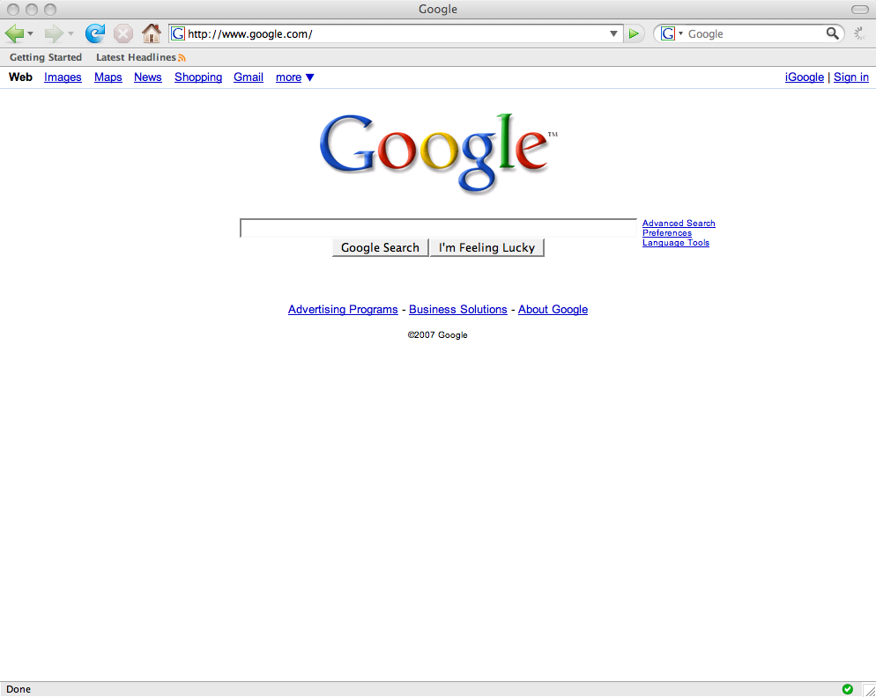


A Simple Example
Fred is a system administrator
But Fred is a also a normal user
To:Fred
From: Dick
Subject: Fun URL
------
Hi, Fred. I found this neat URL
. . .
Fred should operate under one role while doing system administration
And another role while doing normal stuff

Slide 10
Continuing With Our Example
He decides to upgrade the C++ compiler
Fred logs on as “fred”
He reads his email
So he changes his role to “sysadmin”
To:Fred
From: Dick
Subject: Fun URL
------
Hi, Fred. I found this neat URL
. . .
To:Fred
From: Dick
Subject: Fun URL
------
Hi, Fred. I found this neat URL
. . .
To:Fred
From: Dick
Subject: Fun URL
------
Hi, Fred. I found this neat URL
. . .
To:Fred
From: Dick
Subject: Fun URL
------
Hi, Fred. I found this neat URL
. . .
Then he has the privileges to upgrade the compiler

Slide 11
What Has Been Gained?
While reading mail and surfing the web, Fred can’t upgrade the C++ compiler
  He doesn’t have the access rights
So if he accidentally downloads malicious code,
  It can’t “upgrade” the compiler
We have applied time division separation of privilege to Fred’s operations

Slide 12
Changing Roles
Role based access control only helps if changing roles isn’t trivial
  Otherwise, the malicious code merely changes roles before doing anything else
Typically requires providing some secure form of authentication
  Which proves you have the right to change roles
  Usually passwords, but other methods possible

Slide 13
Practical Limitations on Role Based Access Control
Number of roles per user
Problems of disjoint role privileges
System administration overheads

Slide 14
Number of Roles Per User
Each new role requires new authentication
Less secure if the authentication is the same for each role
  E.g., Unix sudo, which only requires your basic password
But how many passwords will people remember?
  And how often will they be happy to type them?

Slide 15
Problems of Disjoint Roles
The least privilege benefit is only achieved if each role has different privileges
  More secure if roles aren’t supersets of other roles
But that may cause difficulties
Users must remember which role allows which operations
Especially difficult if certain operations require privileges from different roles

Slide 16
Problems of System Administration
Access control is only useful if permissions are set correctly
  For all subjects and objects
The more subjects there are, the more work system administrators must do
  Since each subject needs to get only the proper privileges
More chances something will be set up wrong
  Or will not be properly updated when conditions change

Slide 17
RBAC In Real Systems
Windows has provided an RBAC API since Windows Server 2003
  Authorization Manager
Most Linux systems have RBAC add-ons
  SELinux includes RBAC
  Some other Linux distributions do, too
Also lots of special tools to build RBAC systems under Windows

